Slide 1
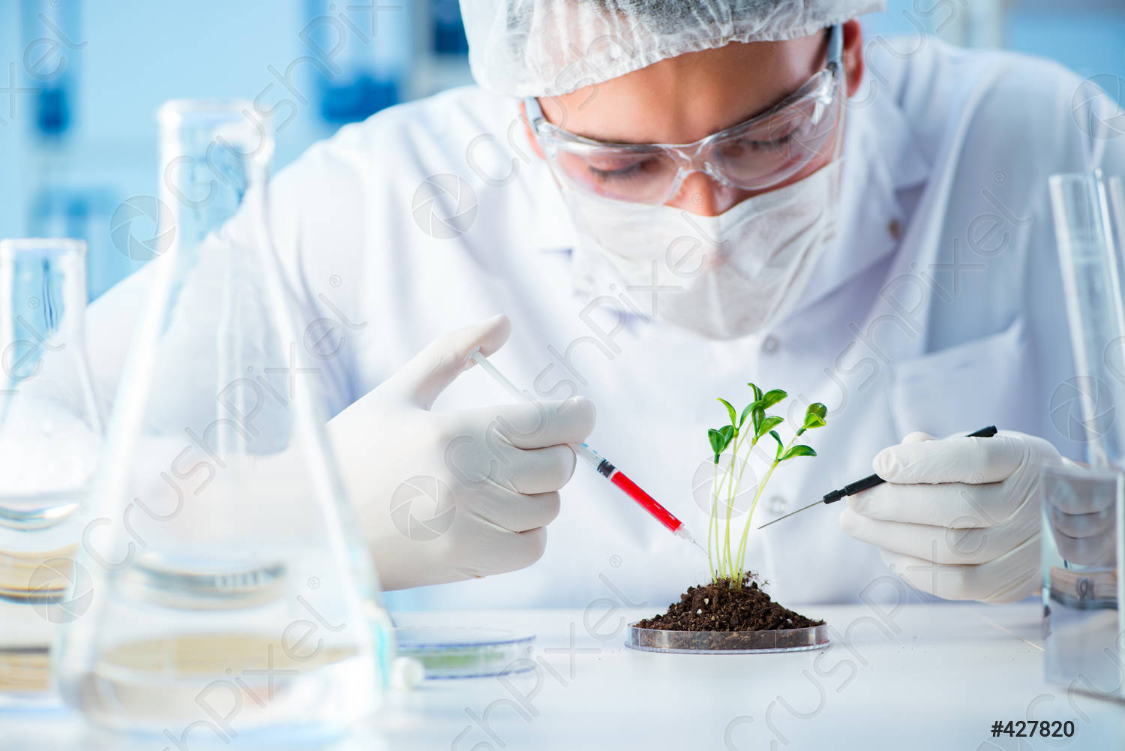
Applications of Biotechnology
Name :- Abeydeera N.N.
ID :- HS21910722
Module Code :- SC1172
Module Name :- Introduction to Information Technology

Slide 2
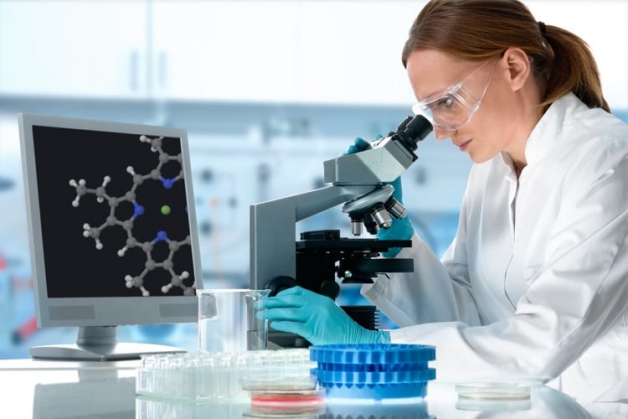
What is Biotechnology..?
Biotechnology is,
the use of biological systems
the use of the living organisms
to make technological advances
adapt technologies to various fields.
Biotechnology includes applications in multiple fields, from agricultural practice to the medical sector.
Notes:
Biotechnology is particularly vital when it comes to the development of minuscule and chemical tools, as many of the tools biotechnology uses exist at the cellular level.

Slide 3
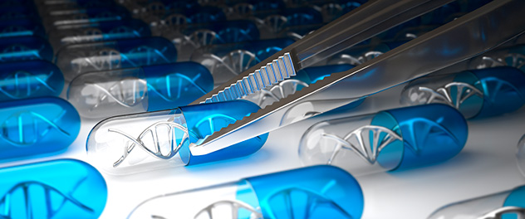
Biotechnology in Medicine
Modern Biotechnology has many applications in medicine, like Pharmacogenomics, Pharmaceutical drug and genetic testing.
Pharmacogenomics
Pharmacogenomics is the study of the role of the genome in drug response.
This analyzes how the genetic makeup of an individual affects their response to drugs.
It deals with the influence of acquired and inherited genetic varication on drug response
Notes:
It deals with the influence of acquired and inherited genetic varication on drug response in patients by correlating gene expression or single nucleotide polymorphisms with pharmacokinetics and pharmacodynamics.

Slide 4
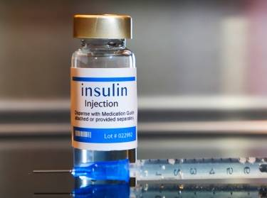
Genetically Engineered Insulin
We can use bacteria to produce human insulin
We grow bacteria in large amounts and also we can also mass-produce human insulin.
Insulin consists of two short, polypeptide chains – chain A and B, linked via disulfide bridges. Insulin is produced as a ‘Prohormone” in mammals. This Prohormone has an extra peptide. The C peptide, which needs to be removed to give rise to mature insulin.
Notes:
.

Slide 5
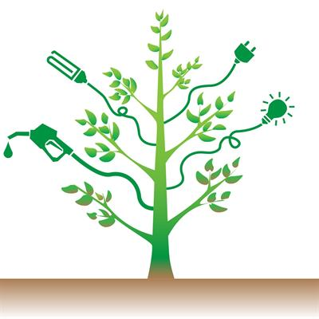
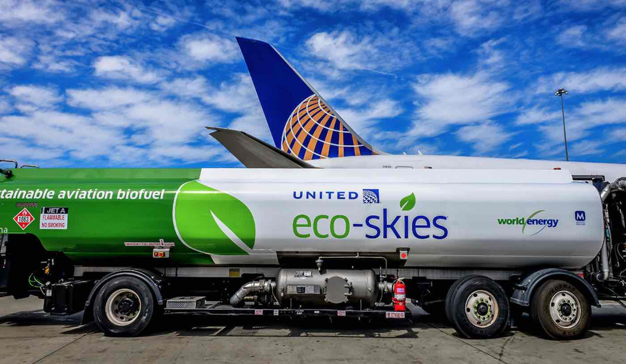
Biotechnology in Agriculture
Biofuels
The agricultural industry plays a major role in the production of biofuels and consuming resources and also as the feedstock for fermentation and cleaning of biofuel, biodiesel, and bio-ethanol.
Genetic engineering and enzyme optimization techniques are being used to develop improved quality feedstock for more efficient change, and higher BTU ( British Thermal Unit) outputs for resulting better fuel products.
High yielding, energy-dense crops can minimize relative costs associated with harvesting and transportation, resulting in higher value fuel products.

Slide 6
References
https://fdocuments.in/document/application-of-biotechnology-in-agriculture-ppt-by-anila-rani-pullagura-58b923f85be72.html
https://byjus.com/biology/application-biotechnology-medicine/
https://en.wikipedia.org/wiki/Biotechnology
https://www.conserve-energy-future.com/biotechnology-types-examples-applications.php
https://en.wikipedia.org/wiki/Pharmacogenomics

